Slide 1
Verification Through Testing
Chris Baldassano
PSYC GR6130, Fall 2019

Slide 2
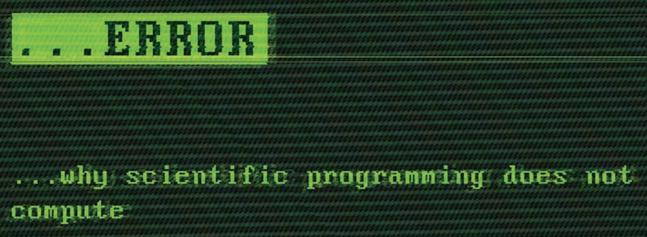
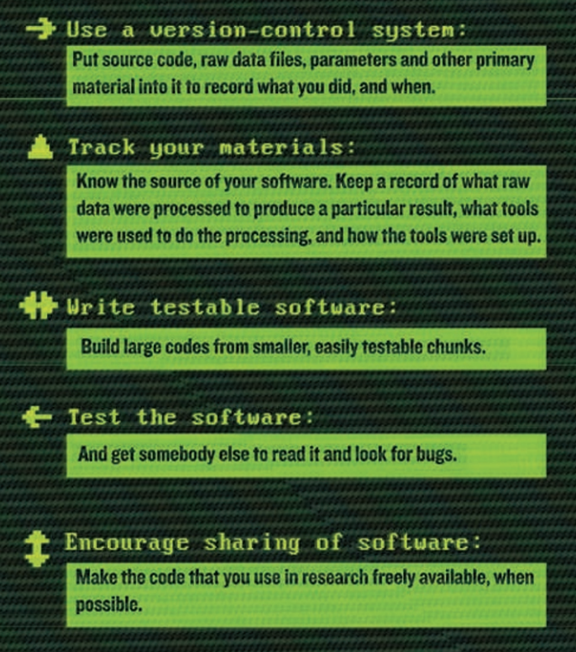
Zeeyz Merali, Nature 2010

Slide 3
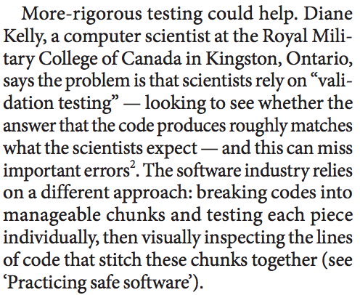
Zeeyz Merali, Nature 2010

Slide 4
Unit testing
Rather than testing an entire analysis pipeline as a black box, we can create small, simple tests for each piece of an analysis
These unit tests allow us to detect problems with specific units of a pipeline, and are complementary to pipeline-level tests such as those discussed last week

Slide 5
Testing Using simulated Data
Black box pipeline
Manuscript text
Analysis 1
Plot results
Real paper
Real Data
Analysis 2
Plot results
Simulated Data

Slide 6
Unit testing
Test 1.A
Manuscript text
Analysis 1
Plot results
Real paper
Test 1.B
Real Data
Analysis 2
Plot results
Test 2.A

Slide 7
Regression testing
Unit tests that run automatically can serve as regression tests
https://searchsoftwarequality.techtarget.com/definition/regression-testing

Slide 8
When to Unit test?
For research code, unit testing is most useful:
For checking new, complex code
When creating a library for use by others
For developing new, complex code (“test-driven development”)
What is a “unit”?
Usually individual functions
“When a test fails, you should know exactly where to look for the problem in your code” - Hadley Wickham
Could also apply to intermediate units, e.g. classes or analyses

Slide 9
Unit Testing Frameworks
Using a unit testing framework makes things much simpler
Allows you to easily run all tests and get a report
Functionality for checking meta-issues e.g. checking that exceptions get thrown
Two we’ll discuss today:
R: testthat
Python: pytest

Slide 10
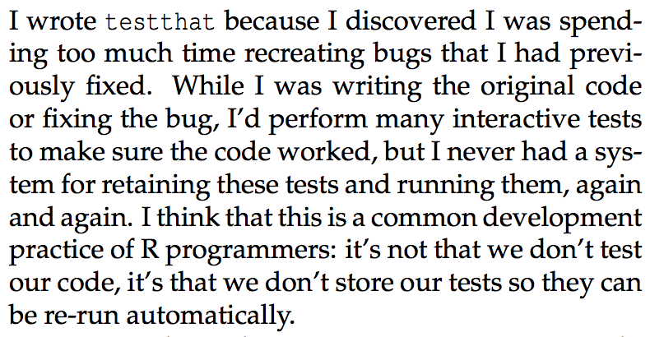
testthat
Hadley Wickham

Slide 11
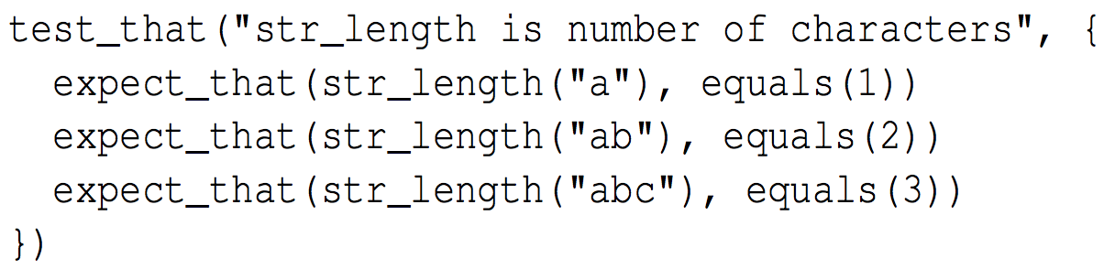
testthat
Each test consists of one or more expectations
Name of test
Expectation

Slide 12
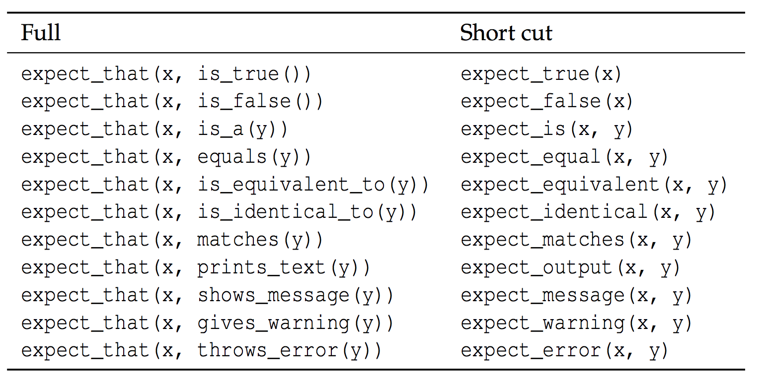
Testthat Expectations

Slide 13
Running testthat
Tests should be put in one or more files which are separate from your main analysis (but source your analysis functions)
Each file should start with the line context(“name”) as a label
Run a test file with test_file(), run all tests in a directory with test_dir() (or Ctrl/Cmd + Shift + T in RStudio)
Can force tests for all GitHub pushes using Travis
Simple to set up and free for small projects
Good for regression testing
Good for collaborative projects

Slide 14
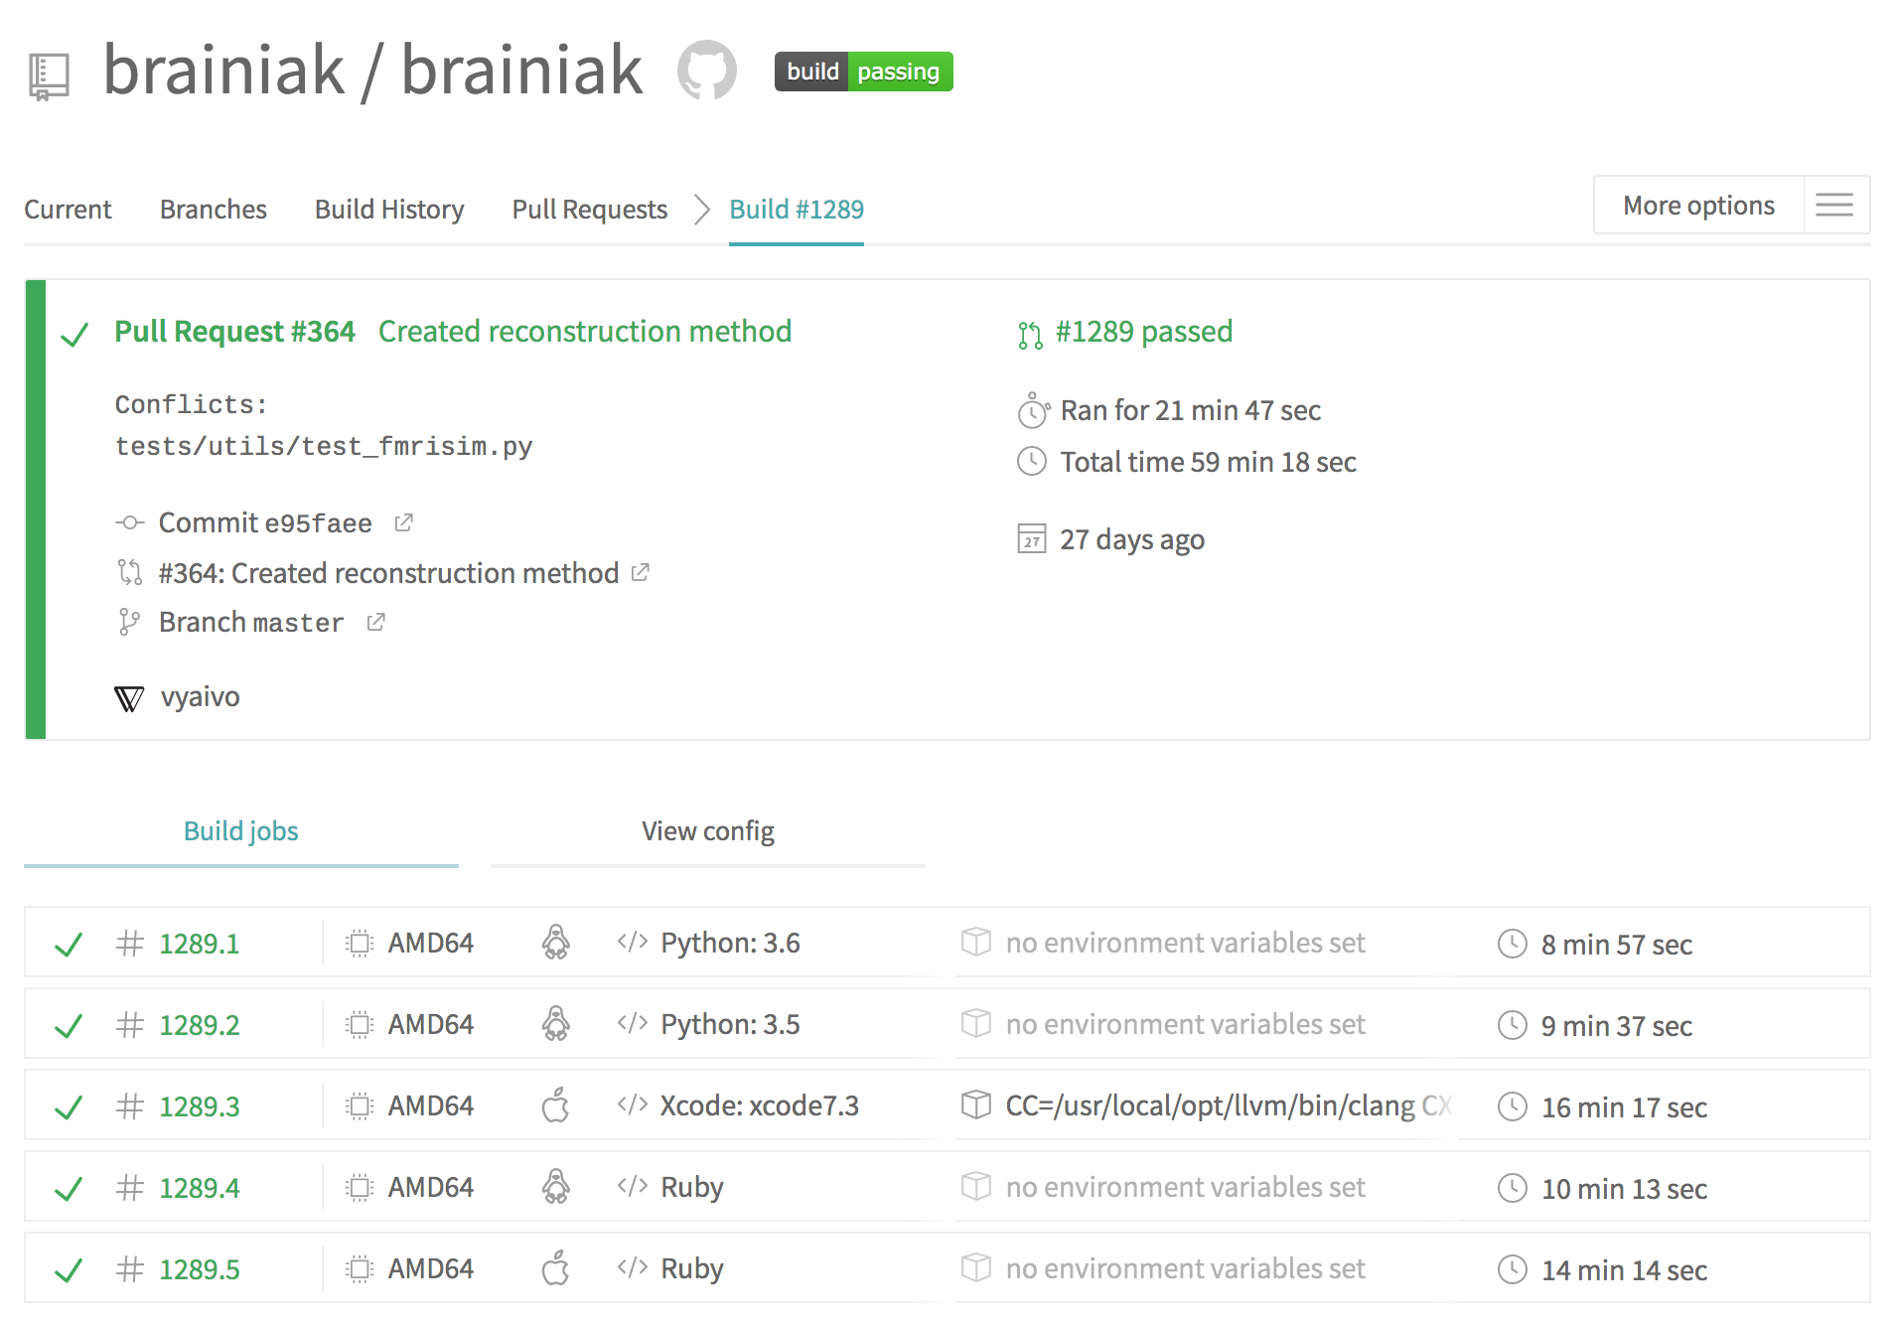

Slide 15
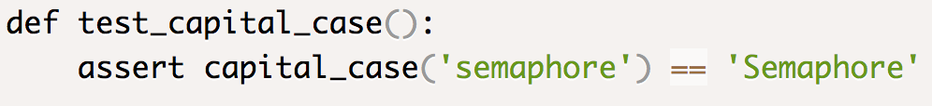
Pytest
The simplest (IMO) python testing framework
All you need to do:
Make a file with test_ or _test in the name
Create functions starting with test
End the function with an assert statement

Slide 16
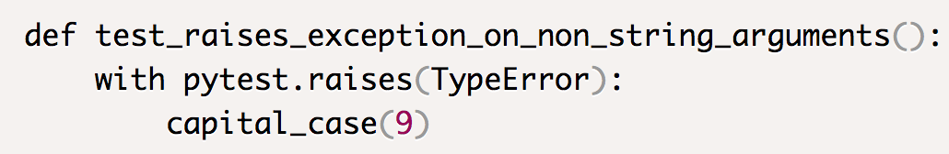
Pytest – Testing Exceptions
Like testthat’s expect_error(x,y), we may want to check that an exception gets thrown
Can use the pytest.raises() context, which will catch the Exception so that it doesn’t derail the testing

Slide 17
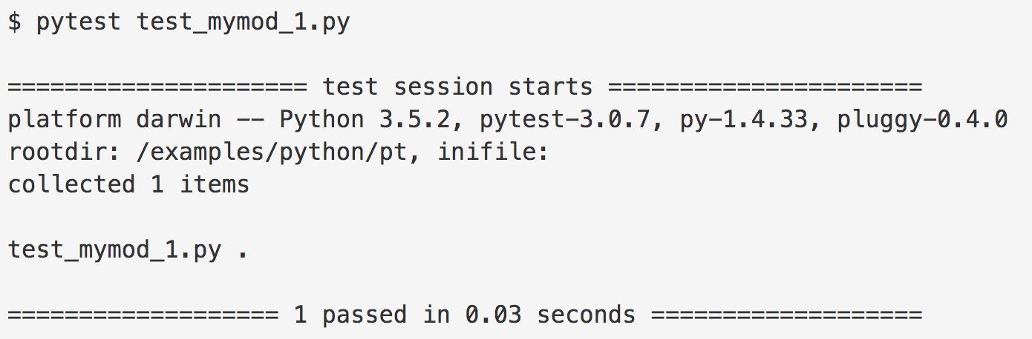
Running Pytest
You can run individual tests within IDEs like PyCharm
You can run some or all tests from the command line

Slide 18
Lab
Accept assignment and copy clone URL but do not manually clone: https://classroom.github.com/a/5eQjhlvX
Open PyCharm, choose Check out from Version Control and use URL to clone assignment into a new project
Open test_classify.py and follow the instructions in the comments at the top of the file

